Slide 1
Introduction to Saltstack
Our Agenda
^{Introduction to DevOps}
What is Saltstack and what does it do?
^{Saltstack components}
^{Installing Saltstack}
^{Configuring the Salt Master}

Slide 2
Introduction to Saltstack
Our Agenda
^{Configuring a Salt Minion}
The salt and salt-call commands
^{Salt PKI}
^{Salt States}

Slide 3
Introduction to Saltstack
Our Agenda
^{Introduction to YAML}
The structure of a salt state file.
^{Salt state declarations}
^{Salt grains}
^{Salt pillars}

Slide 4
Introduction to Saltstack
Our Agenda
Introduction to the Jinja2 templating system.
^{Salt package management (SPM)}
^{Salt reactors}
^{Salt beacons}
Example of third party integration with Nagios.

Slide 5
Introduction to Saltstack
What is DevOps?
All about bringing together developers and operations teams
^{Automating the environment}
Measuring application performance

Slide 6
Introduction to Saltstack
Automate everything
^{Automate code testing}
^{Automate workflows}
^{Automate infrastructure}

Slide 7
Introduction to Saltstack
Constant iteration of development
Write new features and bug fixes in small chunks
Automatically create, test and monitor new software additions

Slide 8
Introduction to Saltstack
Synchronize and Monitor environments
Identical environments for development, test and production
Adopt iterative processes to monitor and measure code and operations daily.
Improve ability to quickly respond to customer concerns and market conditions.

Slide 9
Introduction to Saltstack
Use source code control
Manage and document all changes to application code
Manage and document all changes to configurations and documentation.

Slide 10
Introduction to Saltstack
Reduce time to market
Use devops to reduce the time it takes to bring new features and bug fixes from weeks and months to days and hours.
Deploy frequently using an Agile like methodology.

Slide 11
Introduction to Saltstack
What is SaltStack?¶
A tool to turn your infrastructure into software.
Automates packing and provisioning of code to your IT environment.
^{A massive finite state machine}
Configuration manger for your operations devops and cloudops environments.

Slide 12
Introduction to Saltstack
What does Saltstack allow us to do?
Describe our infrastructure with code.
Makes our infrastructure scalable
Makes our infrastructure reliable.
Gives us consistent environments.
^{Better security}
Ability to quickly duplicate our environments.
Simplifies auditing and tracking capabilities

Slide 13
Introduction to Saltstack
Managing infrastructure as code
^{Gives us revision control}
Allows use of bug tracking and ticketing systems.
Ability to do peer review before changes happen.
Gives us infrastucture design patterns.
Test infrastucture changes the same way we test application changes.

Slide 14
Introduction to Saltstack
Monitoring and Metrics
Allows to track every possible resource
Gives us alerts on all services, availability and response times
^{Capture, learn and improve}
Share access and data with everyone on the team
Plan metrics and monitoring into the application lifecycle.
Easily integrate third party monitoring and logging tools.

Slide 15
Introduction to Saltstack
Saltstack components¶
^{Salt Master}
^{Salt Minions}
^{Execution Modules}
^{States}
^{Grains}
^{Pillars}

Slide 16
Introduction to Saltstack
Saltstack components¶
^{Top File}
^{Runners}
^{Returners}
^{Reactors}
^{Salt Cloud}
^{Salt SSH}

Slide 17
Introduction to Saltstack
Salt Master
^{Central Management Server}
Used to send commands and configuration data to salt minions running on managed systems.

Slide 18
Introduction to Saltstack
Salt Minion
Software that runs on a managed system.
Receives commands and configuration data from the Salt master

Slide 19
Introduction to Saltstack
Execution Modules
Ad hoc commands executed from the command line against one or more managed systems.
Perform real-time monitoring, status and inventory
Run one-off commands or scripts
^{Deploying critical updates.}

Slide 20
Introduction to Saltstack
States
A representation of a system configuration. Can be declarative or imperative.
Grains
Static system information about the managed system.
Examples include the operating system. CPU, Memory, and other properties.
You can define customized grains (properties) for your systems.

Slide 21
Introduction to Saltstack
Pillars
^{User defined properties.}
Stored securely on the salt master.
Assignable to one or more minions using targets
Examples include network ports, file paths, passwords, configuration parameters

Slide 22
Introduction to Saltstack
Top file
Matches states and pillar data to minions
Runners
Modules that execute on the salt master to perform tasks.
Examples include runners that report job status, connection status, and query minions

Slide 23
Introduction to Saltstack
Returners
Modules that can return data to various sources, such as a database.
Returners can run on the Salt minions or the Salt master.
Reactor
Component that can be programmed to trigger reactions to specific events.

Slide 24
Introduction to Saltstack
Salt Cloud
Allows provisioning of systems on cloud providers or hypervisors
Immediately brings these systems under salt management.
Salt SSH
Allows us to run Salt commands over SSH for systems that do not have a minion provisioned.
.

Slide 25
Introduction to Saltstack
Architectural overview of remote execution
Salt is a highly configurable, scalable and robust application that allows one master to manage thousands of minions simultaneously with almost no performance loss.
This means that the time required to update many minions is at worst a logarithmic function rather than a linear or exponential function.
All Salt minions receive commands at the same time. Salt can use multiple protocols to achieve this, however the recommended (and default) protocol is the ZeroMQ message queuing system.
While Salt can interface with many types of data stores, it's real win is being able to query minions in real time.

Slide 26
Introduction to Saltstack
Architectural overview of remote execution
While Salt mainstains a master/slave relationship between the master and the minions, communication with the minions is mostly a set of instructions or commands to run. The minion is responsible for doing the heavy lifting and returning the results back to the master.
Salt normalizes commands between different hardware platforms. All commands and states are the same regardless of the underlying operating system being run on the minion.

Slide 27
Introduction to Saltstack
Architectural overview of remote execution
Salt will run wherever you can install Python. If a minion cannot run Python, then Salt provides a proxy minion that can interface with the real minion and issue commands on behalf of the master un the minion's native protocol. Additionally, the proxy parses and returns all output from the minion back to the master.

Slide 28
Introduction to Saltstack
Architectural overview of remote execution
Salt can perform all of its functions without requiring or using a programming language (Although you will get its best performance if you know some of the Python programming language).
Everything in Salt is extensible. You can even change the underlying network protocol. You can create your own modules as well. Following is an example of the remote execution architecture diagram.

Slide 29
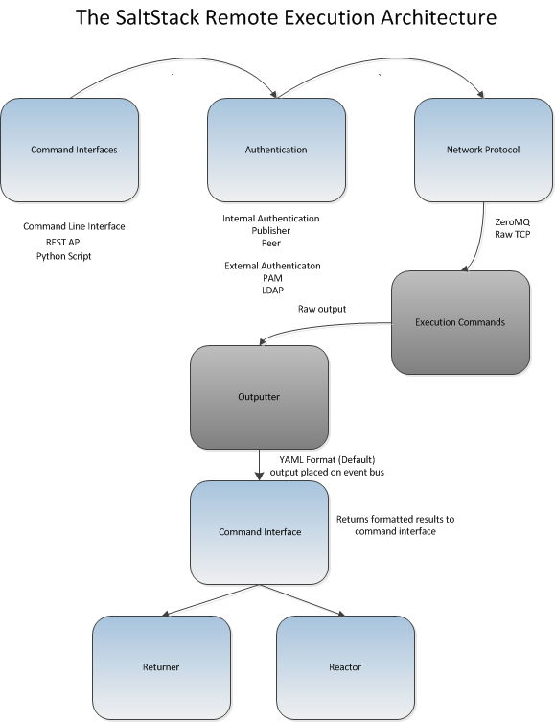
Introduction to Saltstack

Slide 30
Introduction to Saltstack
Looking at this diagram we see the following
Start jobs by calling the command line interface, a RESTful service or a Python script.
Output is formatted by default as YAML, however, other formats, such as JSON, plain text and other formats are also supported.
Results can be stored in many ways, SQL databases, NoSQL databases, flat text files, or any other data store.
The job returner can be any one of a number of plugins to other applications, or even not exist at all.

Slide 31
Introduction to Saltstack
Salt can abstract details of the underlying O/S or applications by using the concept of a virtual module.
For example the pkg module contains support for both the Debian aptpkg and the Red Hat yumpkg modules, however, we only need to call the pkg module directly.
Salt uses a publish/subscribe model (also known as an observer pattern). The Salt minion subscribes to the salt master via a persistent connection. When an even happens, the master publishes messages that the minions can receive and act upon.
.

Slide 32
Introduction to Saltstack
Public Key Infrastructure for secure authentication.
The Salt minion on starting up for the first time looks for a master named salt (The default name).
The minion sends its public key to the master. The master must accept the key, either through manual intervention (The salt-key command) or through an automated process.
Note that the minion won't be able to run any commands until this key is accepted.

Slide 33
Introduction to Saltstack
Public Key Infrastructure for secure authentication.
Encryption is achieved through the use of the Advanced Encryption Standard (AES). The AES key is changed everytime the salt-master reboots or a minion key is deleted.
Access Control verification is done through the Publisher ACL (or whatever ACL standard you choose). Every command run on a minion must be verified through this ACL to make sure that the command sender has permission to do so.

Slide 34
Introduction to Saltstack
Salt Installation and Configuration
^{Getting Salt}
^{Source Installation}
^{Packaged Installation}
^{Salt Bootstrap}
^{Salt Master Network Ports}
^{Minion Firewall}

Slide 35
Introduction to Saltstack
Salt Installation and Configuration
^{Basic Minion Configuration}
^{Salt Security}
Installing salt on Windows minions.
^{Lab 1. Installing Salt}

Slide 36
Introduction to Saltstack
Saltstack basic commands
The four commands used most often on the command line are:
^{/usr/bin/salt}
^{/usr/bin/salt-run}
^{/usr/bin/salt-call}
^{/usr/bin/salt-key}
Of those four commands the one most often used is the salt command.

Slide 37
Introduction to Saltstack
The salt command
The /usr/bin/salt command runs on the salt master and allows salt administrators to execute jobs on salt minions.
The salt command takes as its first argument the minion target. This target can be the wild card operator '*', a specific minion or set of minions, or other criteria, such as a regular expression.

Slide 38
Introduction to Saltstack
The salt command
An example of the salt command is:
^{salt '*' test.ping}
The preceeding command will execute the test.ping method on all salt minions managed by this salt master. test is the salt module name, and ping is the method defined inside the test module. This example shows one of the basic functions of Saltstack, remote execution.
Saltstack comes with a large number of these execution modules, some of which will be explored in this course.

Slide 39
Introduction to Saltstack
Salt-call. Execution on the minion.
Salt-call allows us to run a specific command on a minion itself rather than on the master. Usually, this is used for debugging and testing purposes. Note that you can use this command on the salt master itself because the salt master is running a minion as well.
^{salt-call test.ping}
Note that in this example, we don't need to specify a minion target as the salt-call command runs only on the localhost.
Salt-call is also used in a salt topology where there is no master, only minions.

Slide 40
Introduction to Saltstack
Salt-run. Executing directly on the master.
Salt-run allows jobs to run directly on the salt master. This is useful for a number of reasons
Coordinating tasks across minions. With the salt command, all minions execute the job concurrently. However, there are times when it is desirable to have the minions execute a job sequentially instead.
Accessing data that is only available on the master.
^{salt-run manage.up}

Slide 41
Introduction to Saltstack
Salt-run. Executing directly on the master.
Internally, the manage.up function calls test.ping. It is used to determine whether the minion is up and running and managed by the salt master. As with salt-call, no minions are targeted. This command runs only on the salt master.

Slide 42
Introduction to Saltstack
Salt-key, managing the Salt PKI infrastructure.
Salt communicates between the master and the minions using an encrypted channel for security. Additionally, authentication and authorization must be established between the master and the minion.
The salt master keeps a record of all its minions and whether or not they are trusted. There are three possible states.

Slide 43
Introduction to Saltstack
Salt-key, managing the Salt PKI infrastructure.
Accepted. The master has accepted the public key of the minion.
Unaccepted. The master has not yet accepted the public key of the minion.
Rejected. The master has rejected the public key of the minion.
We use the salt-key command to view the public key infrastructure of Saltstack.
Simply typing in salt-key on the command line will print out the trust state of all the minions.

Slide 44
Introduction to Saltstack
Master Files | Description
/etc/salt/pki/master/master{pub.pem} | The Salt Master's public and private keys
^{/etc/salt/pk/master/minions} | Public keys of every accepted minion
/etc/salt/pki/master/minions_rejected | Public key of every unaccepted minion

Slide 45
Introduction to Saltstack
Minion Files | Description
/etc/salt/pki/minion/minion.{pub,pem} | Minion's public and private key ^{keys}
/etc/salt/pki/minion/minion_master.pub | The public key of the salt master

Slide 46
Introduction to Saltstack
The Salt publish/subscribe model.
Saltstack works using a publish/subscribe model. The saltmaster will publish events on the ZeroMQ bus that the salt minions will subscribe to. The minions look at the target in the message to see if this message is relevant to it.
The master sets up two sockets. Port 4505 is the publish_port. The minions subscribe to the publish port listening for any commands that it needs to run. Anything that is returned from the execution is sent via port 4506 back to the master. Any data returned is processed by a returner.

Slide 47
Introduction to Saltstack
Accessing Saltstack documentation.
Saltstack is written in the Python programming language. One of the features of Python is that of docstrings. Docstrings are simply multiline comments that usually accompany modules, classes and functions.
Saltstack contains extensive docstrings for its codebase. To access these docstrings, we can use the sys execution module.

Slide 48
Introduction to Saltstack
Accessing Saltstack documentation.
To print out the documentation from any execution module simply use the sys.doc command. For example:
salt salt.master sys.doc test.ping
This command will print out the doc string for the ping method from the test execution module.

Slide 49
Introduction to Saltstack
Accessing Saltstack documentation.
If you want to see all of the functions in a module, simply pass the module name to the sys.doc method as the argument. For example:
^{salt salt.master sys.doc test}
Note that if you want to see the documentation for all of the modules in the system, simply run sys.doc with no arguments. However, be aware that it will print a very large amount of text to the screen.

Slide 50
Introduction to Saltstack
Accessing Saltstack documentation.
The sys module has a number of other functions that can assist in understanding salt. For example:
salt salt.master sys.list_modules
salt salt.master sys.list_functions <module name>
salt salt.master sys.argspec <function name>
The first command lists all of the modules available in the current system.
The second command lists all functions within a given module.
The third command lists all of the arguments that a given function requires when called.

Slide 51
Introduction to Saltstack
Accessing Saltstack documentation.
Another important salt executable is salt-call. Unlike salt, which runs its command on the salt master, the salt-call is called from the target minion. This makes it very useful for debugging purposes. For example running
salt-call -l debug state.highstate
on a specific minion will give detailed debugging information on the command line.

Slide 52
Introduction to Saltstack
Targeting minions
It is somewhat rare that you will run a specific execution module that will target all minions. More likely, you will specify some filtering criteria to only target a specific minion or group of minions. For example,
salt 'webserver001' network.interfaces
will run the network.interfaces execution only on the minion with the ID 'webserver001'.

Slide 53
Introduction to Saltstack
Targeting minions
We can target multiple minions by ordering them into a command like so:
salt -L 'webserver001, webserver002, webserver003' network.interfaces

Slide 54
Introduction to Saltstack
Targeting minions
This, however, is the least of what we can do. We can for example target minions by the value of a grain. Recall that grains are platform computed values, such as memory, cpu, operating system type, etc.
Let's now target all minions that run Red Hat Enterprise Linux.
salt -G 'os:RHEL' network.interfaces
We see here that the -G option to salt will expect as the next paramter the value of a specific grain. In this case, the grain is the os attribute and we're looking for all os keys that have the value of 'RHEL'.

Slide 55
Introduction to Saltstack
Targeting minions
We can also target minions using regular expressions. For example, if we name our webservers webserver001 through webserver009 and we'd like to run a command targeting webservers 1-4 and 7, we can do the following:
salt -E 'webserver00[1-47]' network.interfaces

Slide 56
Introduction to Saltstack
Targeting minions
Additionally, we can target minions using pillar data as well.
salt -I 'Region:Asia:Shanghai' network.interfaces
Here, we have a pillar called 'Region', which contains a key value pair <Regional area>:<City>. This command will run the network.interfaces method on all minions in which the key is 'Asia' and the value is 'Shanghai'

Slide 57
Introduction to Saltstack
Targeting minions
Note that if the values in the pillar changes, you must refresh the pillar cache by doing either:
salt '*' saltutil.refresh_pillar
^{or}
^{salt '*' saltutil.sync_all}

Slide 58
Introduction to Saltstack
Targeting minions
We can also match on Internet Protocol addresses.
salt -S 192.168.100.1 test.ping
^{salt -S 10.0.0.0/24 test.ping}
We use the -S option to indicate to salt that we're passing it IP addresses. Note that we can either use the IP address on its own or add a subnet mask as needed.

Slide 59
Introduction to Saltstack
Targeting minions
Saltstack has the ability to do compound matches, i.e. to match on more than one criteria. Let's see an example.
salt -C 'E@webserver00[1-47]' and 'G@os:Ubuntu' network.interfaces
This will return all of the network interfaces from webserver's 001 though 004 and 007 only if the operating system being run by the webserver is Ubuntu.

Slide 60
Introduction to Saltstack
Salt States
The core of the Salt system is the Salt state. States are kept in .sls files known as Salt State Files. Salt State files are data structures that define the desired state of any minion.
These state files are implemented in Python as Python data structures, such as lists, dictionarys, strings and so on.
Salt state files are kept in a heirarchical format known as a state tree with the root of the tree being the top.sls file. Beneath the top level directory you can create directories for each type of state that you wish.
The following slide is an example of a state tree hierarchy.

Slide 61
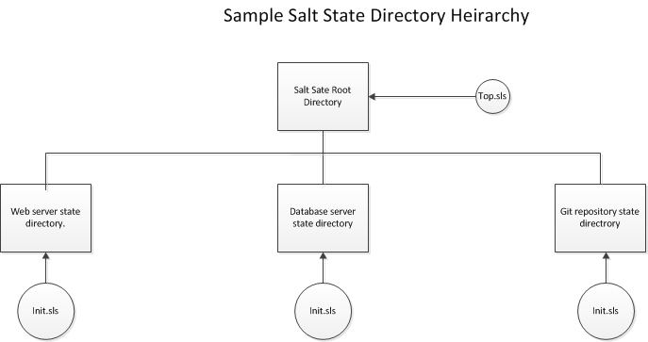
Introduction to Saltstack

Slide 62
Introduction to Saltstack
Salt States
Salt states are stored in files with an .sls extension. These files are in YAML format. YAML is a list of key and value pairs. To look at the documentation for state functions, we can use the sys.state_doc <state module> command.
Note that to run a state, we use an execution module called the state module. Don't confuse the state module with the concept of a state in Saltstack. The state module is what is used by salt to actually implement the defined states that we define.

Slide 63
Introduction to Saltstack
Introduction to YAML
YAML stands for YAML Ain't a Markup Language. YAML is a text based format for creating structured data that is very readable and understandable.
This differs in marked contrast to other types of markup languages such as XML, which is notorious for being difficult to read and expensive to parse.
YAML consists of keys and values, For example let us consider a YAML file which describes an automibile:

Slide 64
Introduction to Saltstack
Introduction to YAML
^{# A YAML example} ^{Mercedes:} ^{Type:} ⁻ ^{Hatchback:} Fuel: "-- 'Petrol' -- 'Diesel'" ^{Model: A} ^{Weight: 1400} ⁻ ^{Saloon:} Fuel: "-- 'Petrol' -- 'Diesel' -- 'Electric'" ^{Model: C} ^{Weight: 2250}

Slide 65
Introduction to Saltstack
Introduction to YAML
Note that we have a top level key, 'Mercedes', which maps to a complex value. We have a list called 'Type' with two elements.
We also have an internal list 'Fuel' which is part of the value mapped to 'Type'.
Notice that YAML uses indentation to resolve heirarchy. 'Type is part of the 'Mercedes' key because it has been indented. If it were on the same indentation level, then it would be a completely separate key/value pair.

Slide 66
Introduction to Saltstack
YAML Best Practices
Use UTF-8 encoding when saving files.
Always use spaces for indentation, never tabs.
Edit with a text editor, not a WYSIWYG editor such as Microsoft Word.
Use a monowidth/monospace font such as Courier when viewing YAML files.

Slide 67
Introduction to Saltstack
State files
You set up the state tree by defining values in the /etc/salt/master configuration file. The file_roots: directive is where you would put file paths. For example:
This sets the state tree root to /srv/salt, which is the default. Note that if you change this value, you must restart the salt master service in order for the change to take effect.
^{file_roots:} ^{base:} ^{- /srv/salt}

Slide 68
Introduction to Saltstack
State files
You set up the state tree by defining values in the /etc/salt/master configuration file. The file_roots: directive is where you would put file paths. For example:
This sets the state tree root to /srv/salt, which is the default. Note that if you change this value, you must restart the salt master service in order for the change to take effect.
^{file_roots:} ^{base:} ^{- /srv/salt}

